Slide 1
Project Status Report
UWA | Exchange Unit Approval Process
10th September 2018

Slide 2
Project Status Report UWA | Exchange Unit Approval Process
 | Weeks
Activities Weeks | 1 | 2 | 3 | 4 | 5 | 6 | 7 | 8 | Break | 9 | 10 | 11 | 12
Unit Nomination Form
Unit Approval Management System
Unit Equivalence Decision Form
Unit Approvals Database
Training, Testing and Documentation
Sprint 1
End
Current
Sprint 2
End
Sprint 3
End
Unit Nomination Form
Unit Approval Management System
Unit Equivalence Decision Form
Unit Approvals Database
Training, Testing and Documentation
Request form is implemented May be further modified for usability when implemented with full system | Mock-ups complete, needs to be validated with users Development started | Meeting with unit coordinator booked to define user flow
Legend:
Not Started
In Progress
Completed
Delayed

Slide 3
Project Status Report UWA | Exchange Unit Approval Process
Components Overview
Unit Nomination Form
Unit Approval Management System
Unit Equivalence Decision Form
Unit Approval Management System

Slide 4
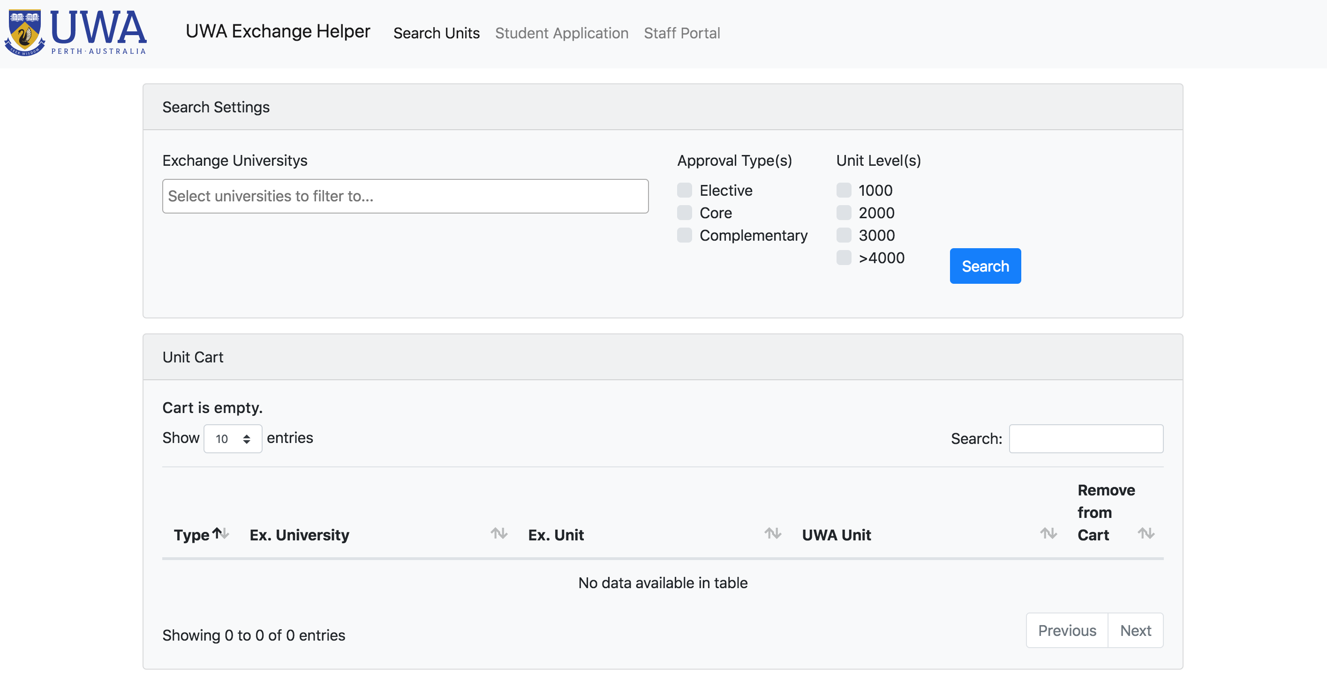
Project Status Report UWA | Unit Nomination Form

